Slide 1
Real time analytics: Kafka + Druid + Superset
DESISLAVA MILUSHEVA / JANUARY 2020

Slide 2

What is Druid ?
Apache Druid (incubating) is a real-time analytics database designed for fast slice-and-dice analytics on large data sets.
Columnar storage format
Realtime or batch ingestion
Indexes for quick filtering
Time-based partitioning
Approximate algorithms
Automatic summarization at ingest time

Slide 3

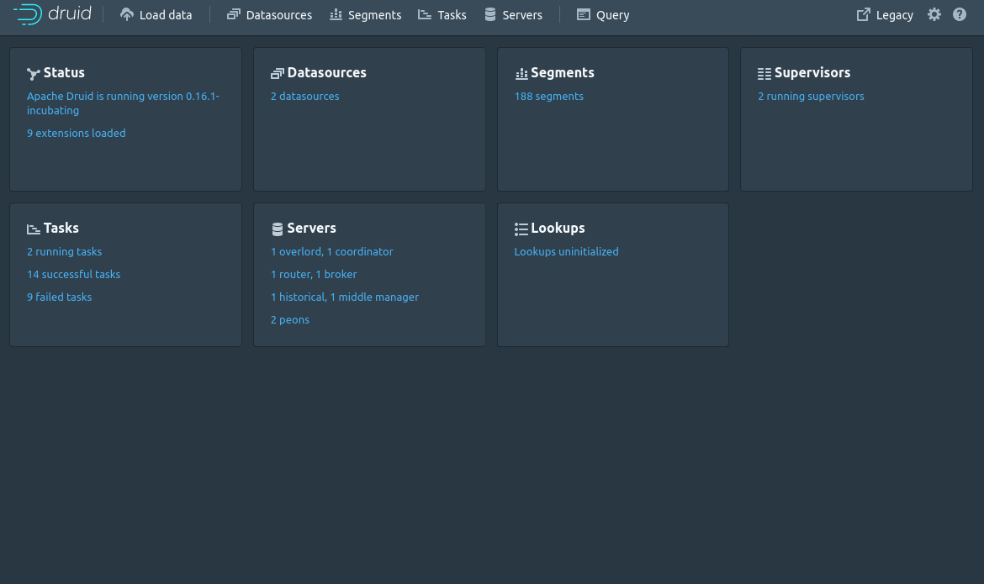

Slide 4
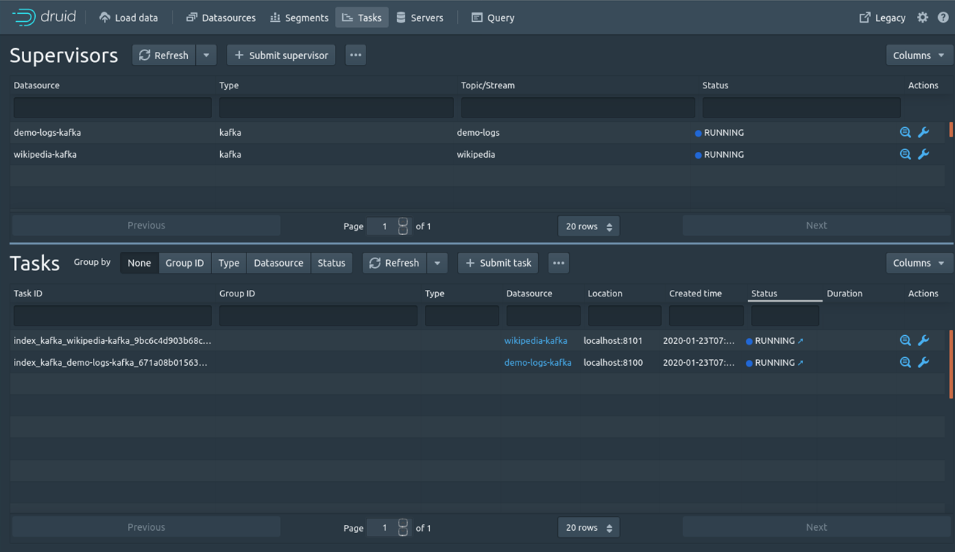

Slide 5
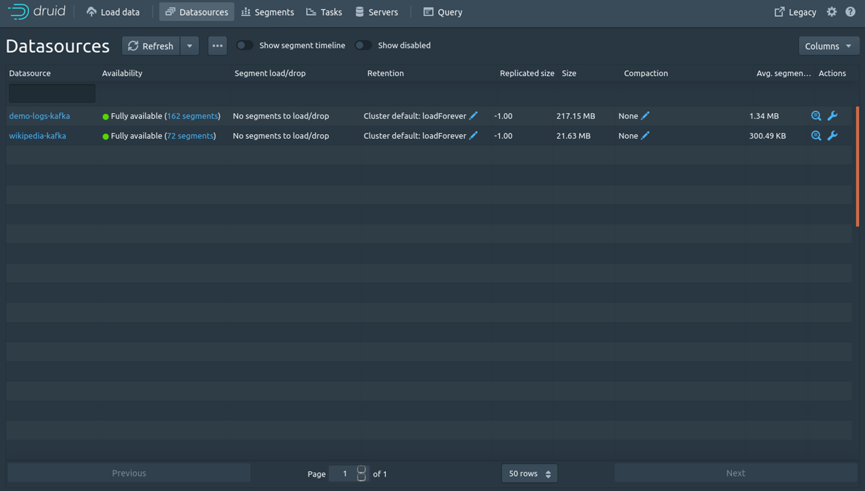

Slide 6

What is Superset?
Apache Superset (incubating) is web application that provides an intuitive interface to explore and visualize datasets, and create interactive dashboards.
A rich set of data visualizations
An easy-to-use interface for exploring and visualizing data

Slide 7
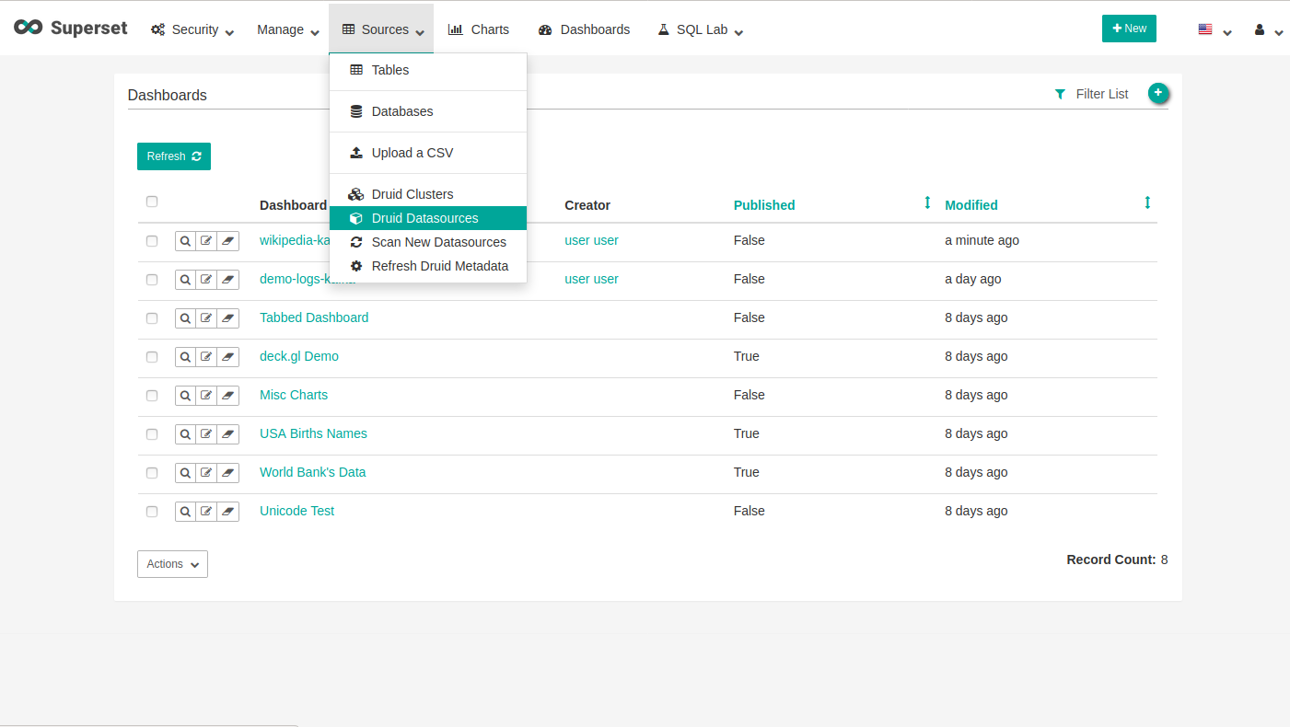

Slide 8






Load data
into Kafka
Visualize data from Druid
Load stream data from
Kafka topic into Druid

Slide 9
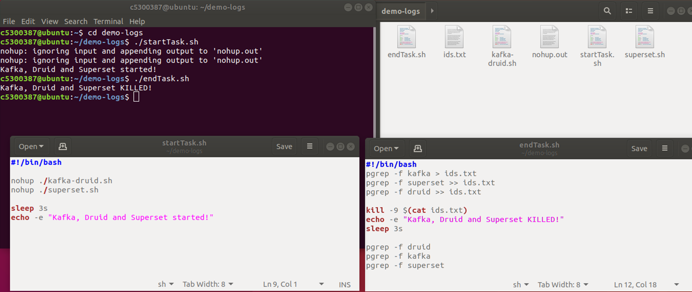
Automate the start of
Kafka + Druid + Superset
(use a shell-script )

Slide 10
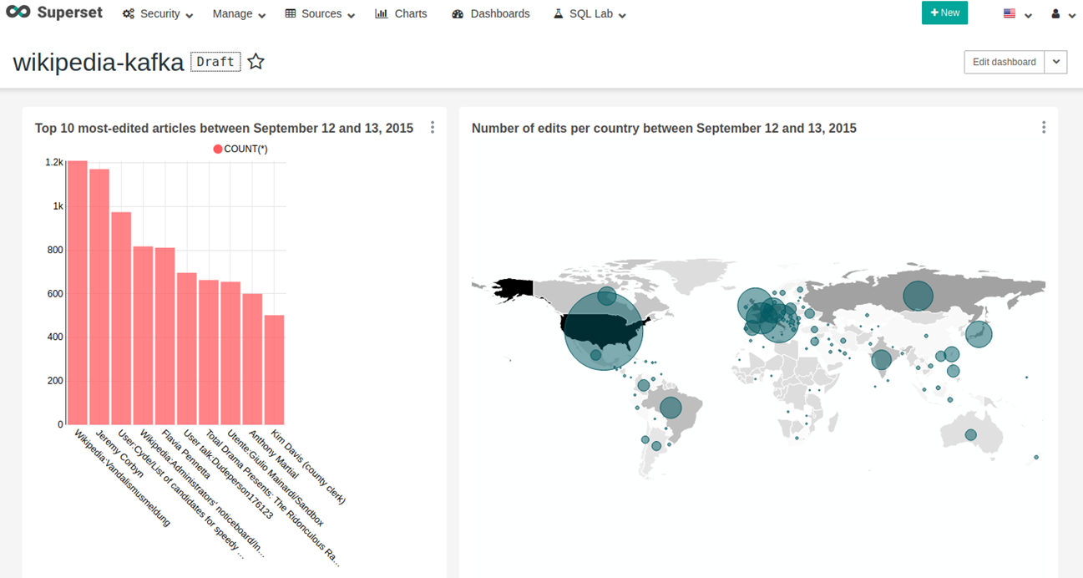
Demo: Wikipedia (real-time) dashboard

Slide 11
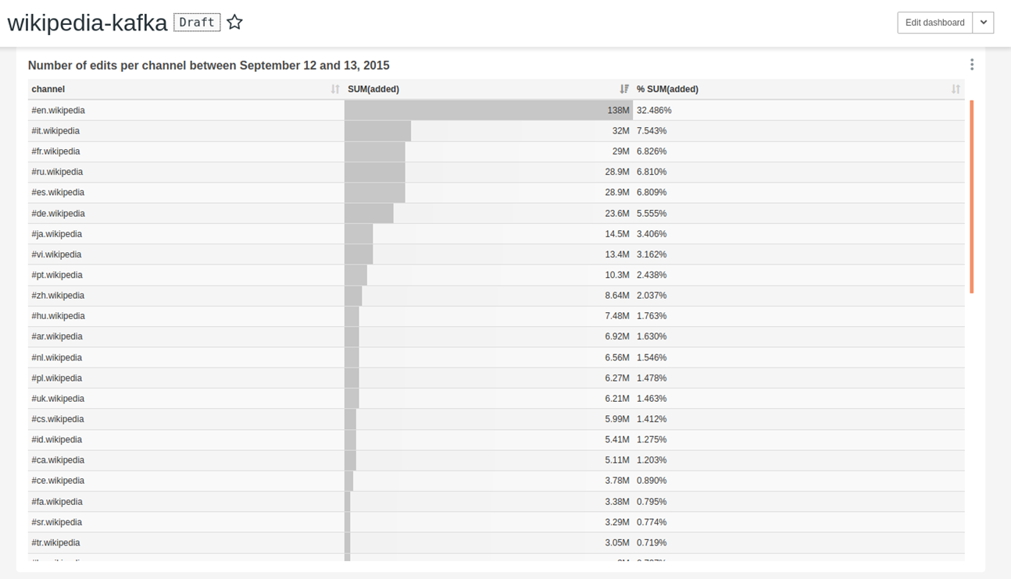
Demo: Wikipedia (real-time) dashboard

Slide 12
Project Websites
Druid - https://druid.apache.org/docs/latest/design/
Superset - https://apache-superset.readthedocs.io/en/latest/
https://blog.godatadriven.com/divolte-kafka-druid-superset

Slide 13
Thank You
For Your Attention

